Slide 1
Congratulations on completing the debates! Now, how does this make you feel?
Choose an emoji to match your mood and tell us why … in 30 seconds 🤔
🤷🏻‍♀️ 😹 😊 😳 👏
🤞 🙏 ⭐️ 😿 🥳
🤢 👋 👍 😩 😡
🙀 🥱 🥴 🙂 😅

Slide 2
Who is behind the debating mask?🤷🏻‍♀️

Slide 4
“When you need me, but do not want me then I must stay. But when you want me but no longer need me, I have to go.”

Slide 6
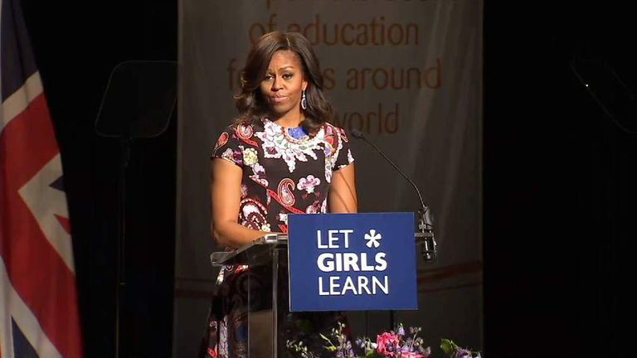

Slide 9
When my world suddenly changed, my priorities changed too. I had two options, one was to remain silent and wait to be killed. And the second was to speak up and then be killed. I chose the second one. I decided to speak up.

Slide 10
If there is one message that echoes forth from this conference, let it be that human rights are women’s rights and women’s rights are human rights once and for all. Let us not forget that among those rights are the right to speak freely — and the right to be heard.’

Slide 12
Be not afeard; the isle is full of noises, Sounds and sweet airs, that give delight and hurt not. Sometimes a thousand twangling instruments Will hum about mine ears, and sometime voices That, if I then had waked after long sleep, Will make me sleep again: and then, in dreaming, The clouds methought would open and show riches Ready to drop upon me that, when I waked, I cried to dream again.

Slide 16
I know I have the body of a weak and feeble woman; but I have the heart and stomach of a king and a king of England too …

Slide 19
Remember, it’s not taking part, its … 😹😹😹

Slide 20
Some of the worst winners’ speeches are at The Oscars … can you do better?

Slide 21
Some of the worst winners’ speeches are at The Oscars … can you do better?
Imagine that you have won the debate today.
Congratulations!
You now have 30 seconds to make your winning acceptance speech without – hesitation, deviation or repetition!

Slide 22
Good Luck, Well Done and keeeeeeeep debating!🤞

