Slide 1
Building your secondary school oracy culture with the ESU
M. Christmas and A. Khan Sullivan, 15/09/2021, Webinar

Slide 2
Housekeeping
Today's session is being recorded
Control your video and microphone settings (please 'mute' when not speaking)
Please check your screen name (please show your name and school)
Use the group chat for questions/comments
Approx. 60 minutes – including Q&A
Matthew Christmas (he/him)
Head of Engagement
Ameena Sullivan (she/her) Senior Education Officer

Slide 3
What is oracy?
The term ‘oracy’ was coined in the 1960s by Andrew Wilkinson, a term to raise the status of speaking and listening in school curriculums
Oracy is both learning to talk, and learning through talk
It’s about having the vocabulary to say what you want to say and the ability to structure your thoughts so that they make sense to others
The Oracy All-Party Parliamentary Group launched the Speak for Change Inquiry in 2019 to improve oracy education for every child in every school.
"It is purposeful classroom talk which develops children’s speaking and listening skills and enhances their learning through the effective use of spoken language."
The provision of oracy in schools is not equal, yet oracy education is critical to addressing inequality in education, and in society.

Slide 4
Why is teaching oracy important?
Improves academic outcomes
Underpins literacy and vocabulary acquisition
Supports wellbeing and confidence
Enables young people to have access to employment and thrive in life beyond school
Develops citizenship and agency
Reasoning & Evidence
Listening & Response
Expression & Delivery
Organisation & Prioritisation
ESU ORACY SKILLSETS
ORACY APPG FINDINGS

Slide 5
What do students and teachers say?
Equipping students with the skills of oracy has unlocked many voices of our students and allowed them to push boundaries in their learning…students now are developing an extra tool in their thirst for learning through debate –
Teacher, St Mark’s Catholic School
It’s helped me develop my skills not just in acting but in how to understand emotions. It’s made me more empathetic. -
Myra, student, Westbourne School, Penarth
Improves academic outcomes
Underpins literacy and vocabulary acquisition
Supports wellbeing and confidence
Enables young people to have access to employment and thrive in life beyond school
Develops citizenship and agency
Through the Schools’ Mace we’ve learnt structured ways to get our point across to other people. It’s a more formal and educated approach to answering questions and finding the best solution. - Arian, student, Woodside High School
Reasoning & Evidence
Listening & Response
The ESU has been very important in helping me to develop confidence in myself and in my own abilities. I got an offer from Oxford and being able to articulate my ideas to the professors there definitely helped. It’s an invaluable skill.
- Patrick Clarke, student, St Francis Xavier’s College, Liverpool
Expression & Delivery
Organisation & Prioritisation
They were able to see past their own mindset and incorporate views from many different angles so as to give their arguments a more holistic strength
– Oracy Culture Award teacher

Slide 6
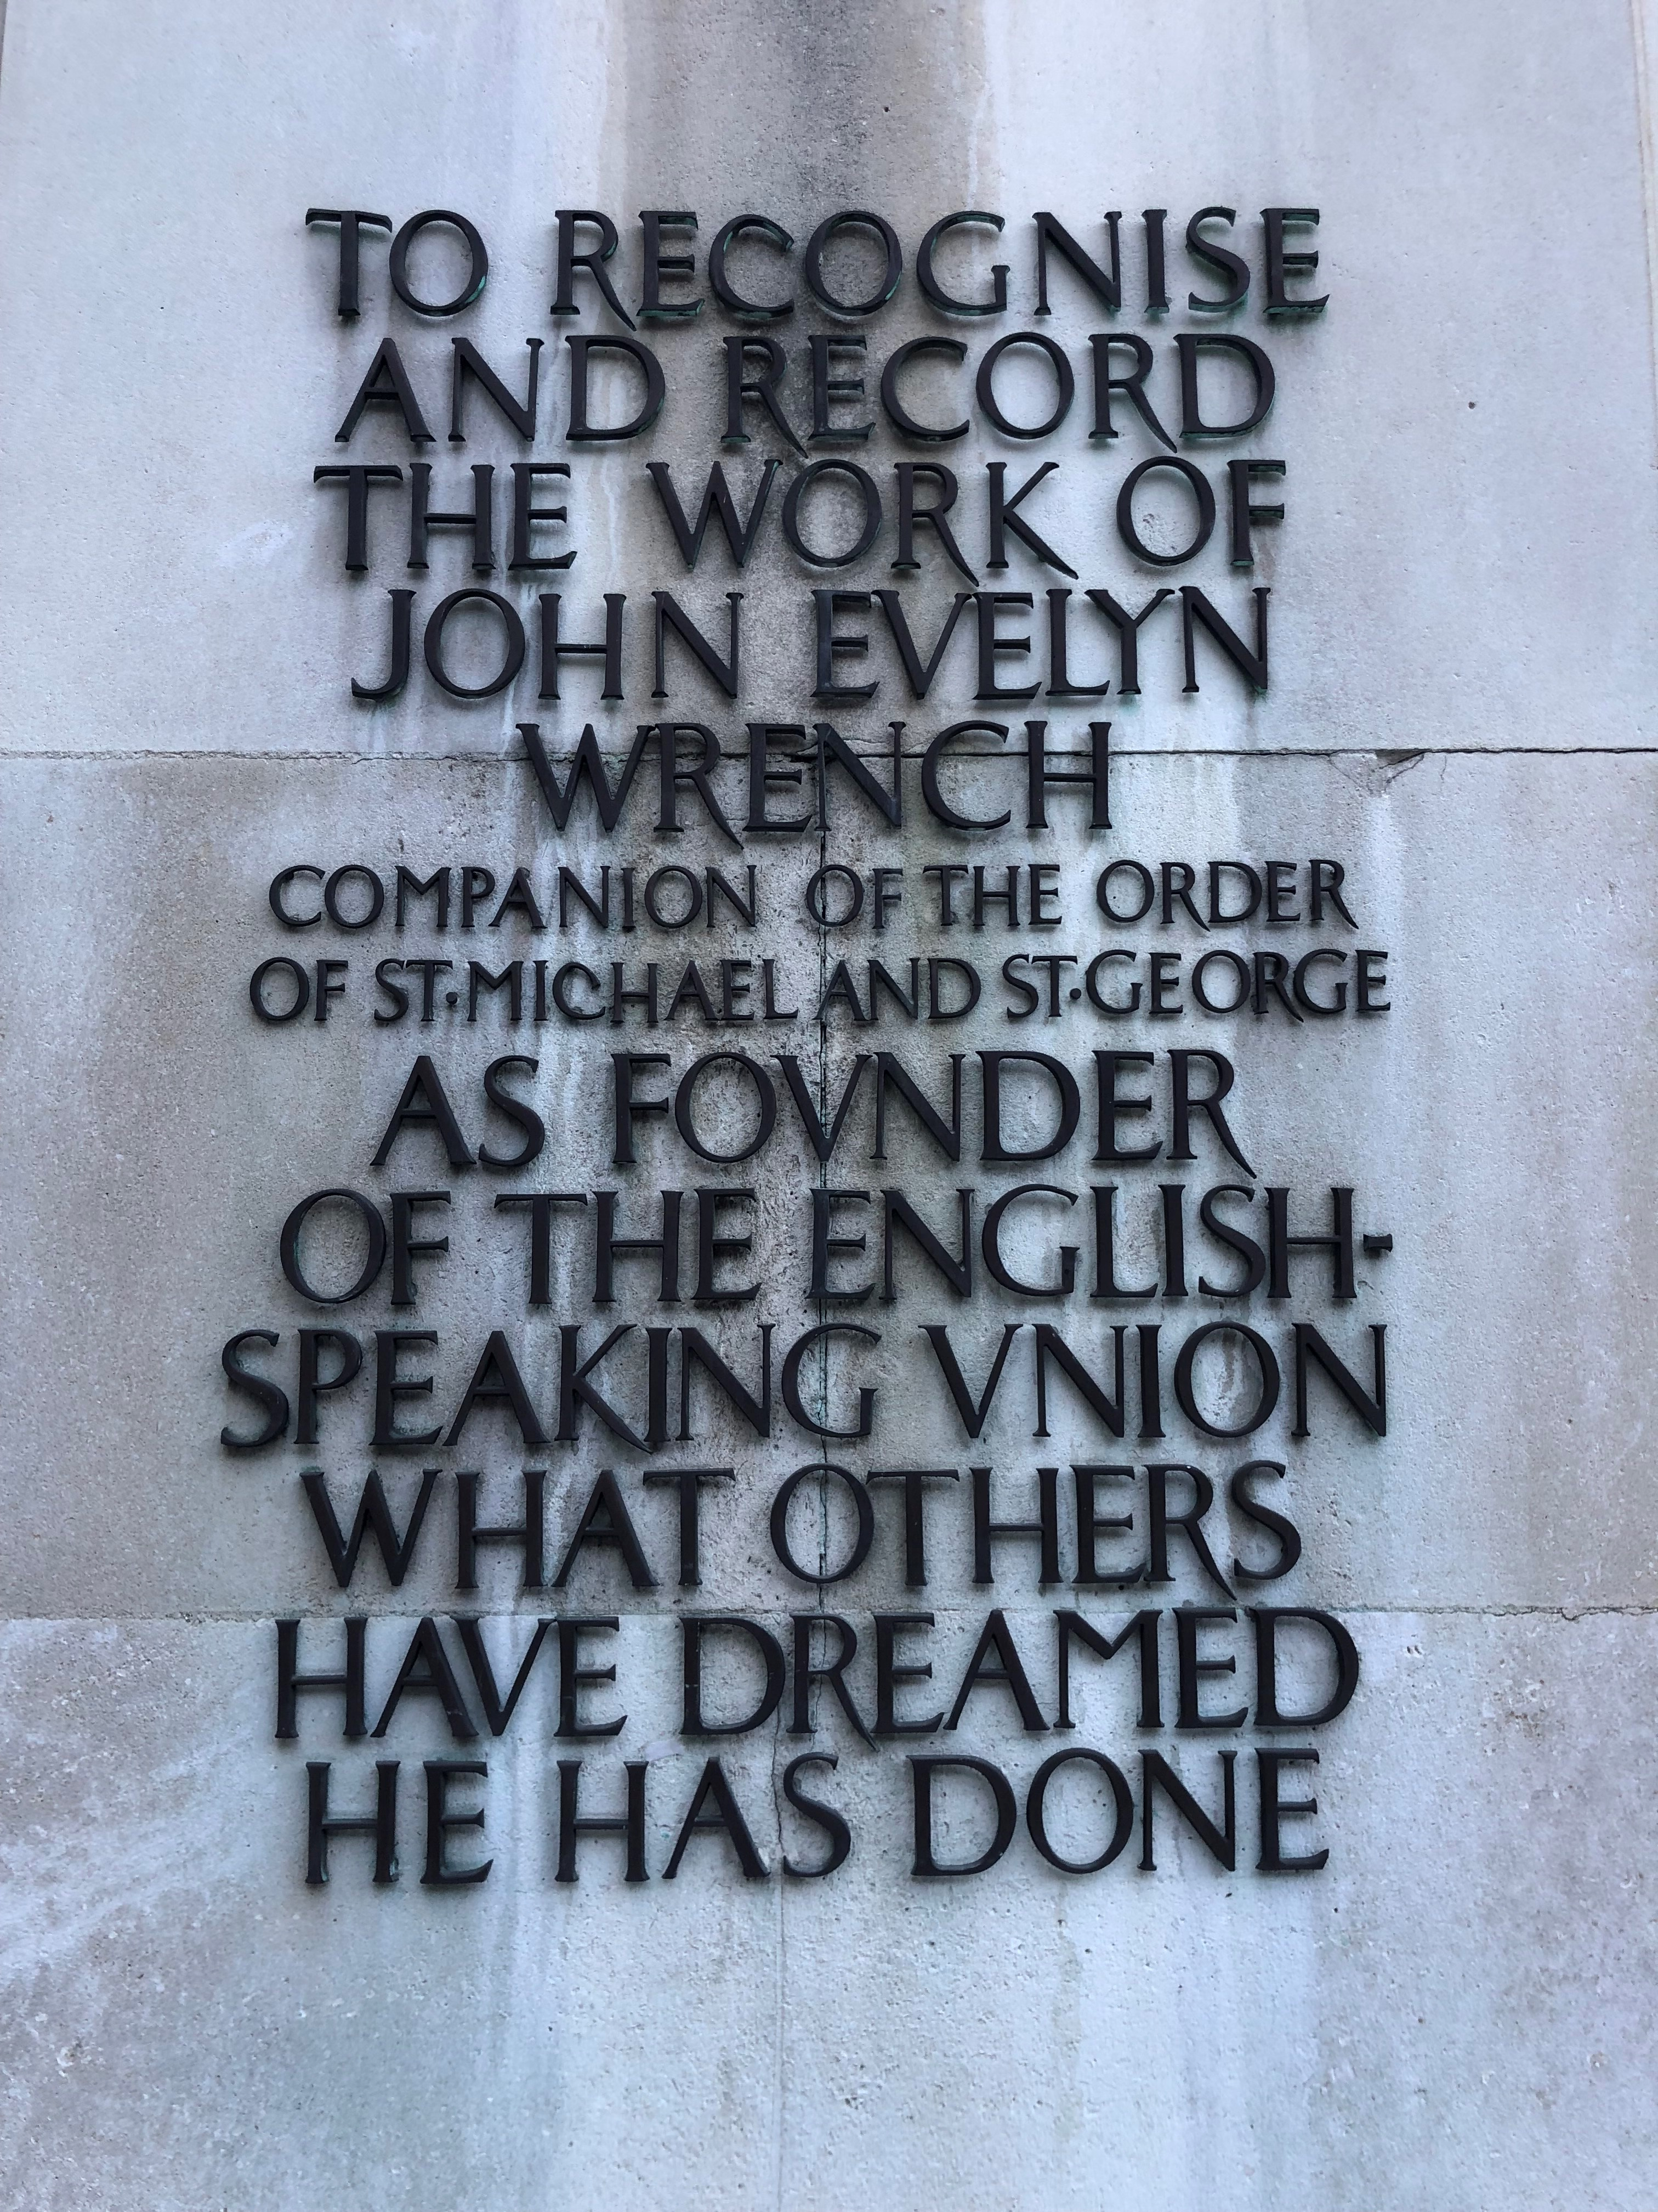
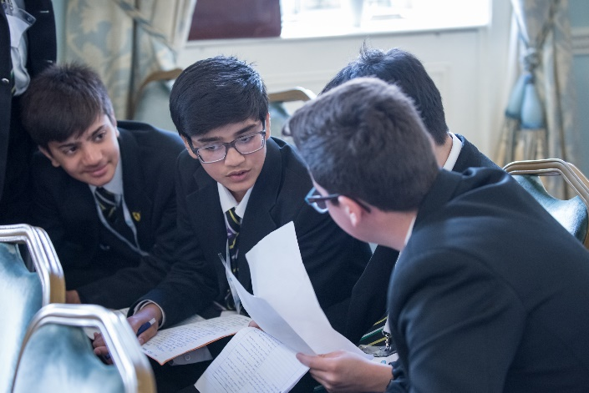
An Introduction to the ESU
The ESU was founded in London in 1918, after the First World War, in the belief that better understanding between peoples could lay the foundations for peace.
The ESU today is an educational charity and membership organisation working to give young people the speaking and listening skills and the cross-cultural understanding they need to thrive: to listen, to speak, and to succeed.
The ESU runs three secondary age competitions, a range of other programmes, and CPD for teachers to promote a whole-school culture of oracy.

Slide 7
Why do schools engage with the ESU?

Slide 8
For Teachers
Free Resources
Our resources are free, ready-to-use and suitable for all levels of experience
Introduction to skillsets
Ice breakers
Activities and lesson plans to support training for all three competitions
Games and exercises across the curriculum (including tutor time, citizenship and science)
Available on our website and additional resources via our newsletter
CPD Workshops
Full-day, half-day or one-hour CPD workshops for up to 16 teachers per trainer
On demand
Trainer-led

Slide 9
Our Secondary School Programmes
Discover Your Voice workshops
Full- or half-day bespoke debating or public speaking workshops
Years 5-13
On demand
Trainer-led
Debate Academy
Week-long friendly and immersive debating summer school
14-18 year olds
Approx. £545, bursaries available
Late July/Early August annually, Stamford School, Lincolnshire
Taught by leading debaters

Slide 10
Our National Competitions
Schools' Mace debating competition
Oldest and largest debating competition for schools in England
Years 7-13
£45 per team (one team per school); subsidies available
Heats begin in November, with the grand final in late March
ESU-Churchill Public Speaking competition
Largest public speaking competition for schools in England and Wales
Years 9-11
£45 per team (up to two teams per school); subsidies available
Heats begin in November, with the grand final in April
Performing Shakespeare competition
Inclusive, accessible competition allowing students in England and Wales to perform Shakespeare
Practise oracy and drama skills. Supports KS3 NC English
Years 7, 8 and 9
£45 per school; subsidies available
Heats begin in January and February, with the grand final in June

Slide 11
Next Steps
Join our free resources newsletter
mailchi.mp/esu.org/resources
Enter the competitions
www.surveymonkey.co.uk/r/esu2021reg
Talk to us about workshops and competitons
Competition@esu.org
Register for our competitions webinar next Wednesday, 4pm
www.esu.org/resources/
Visit our website
www.surveymonkey.co.uk/r/ESUweb
Webinar feedback survey
www.esu.evetbrite.co.uk

Slide 12
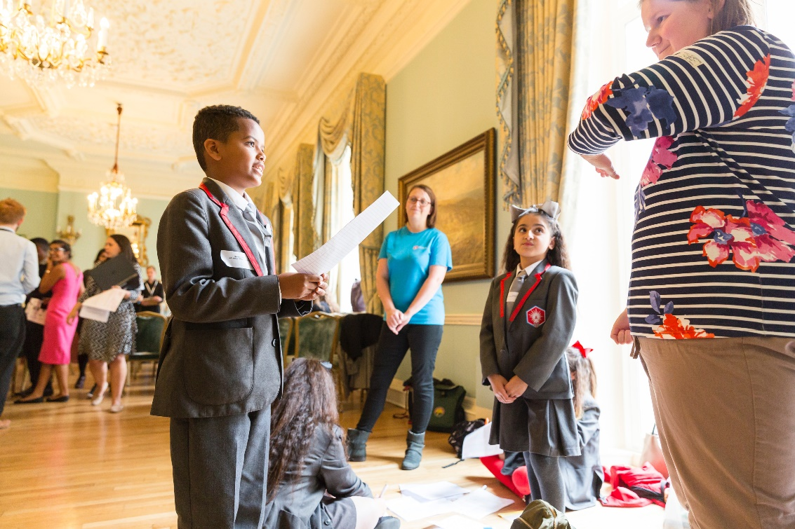
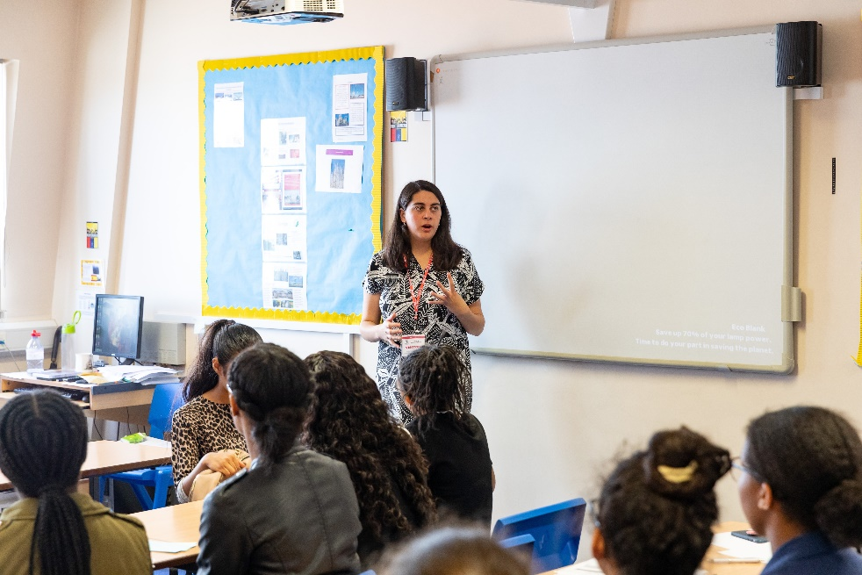
Questions?

