Slide 1
An Introduction to Fusion Skills for Learning
Notes:
Guide to using the slides
The notes for facilitators are a guide only and should be adapted to the level of the learners and the context.
Slides may be added or removed to suit the learning context.
These slides are intended for non-commercial educational and training use only

Slide 2
Where we will go over the next 180 minutes…
What is Fusion?
Self-Assessment of Fusion Skills
Planning personal learning journeys
Notes:
Learning Goals: To gain an improved understanding of fusion skills and the difference these can make to getting your life goals and enjoying learning and work.
To begin the journey to develop and expand your fusion skills.
Learning Objectives:
To introduce fusion skills.
To understand the importance of fusion skills to learning and working.
To enhance your capacities for lifelong learning and understand the significance of becoming a lifelong learner.

Slide 3
Introduction
Your facilitators today
When you see this sign, it gives you some practical hints for applying your learning
When you see this sign, it gives you some more ideas of ways you can take you learning further if you wish
Notes:
Facilitators to add their names and email contacts
Introduce the learning symbols
Explain that different learning methods will be used, and that active participation and questions are encouraged.
There will be some activities where learners can direct their own learning
There will be active participation and groups for social interaction
The facilitators will use a variety of teaching and learning methods, including hands-on learning
Learners are asked to introduce themselves so that the facilitators can make the learning relevant to what
learners will be doing when they leave the course and relevant to their current level of competence and experience.
We are all part of a supportive and respectful learning environment. There will be breaks, and opportunities to practice our Fusion Skills.
questions and correct mistakes

Slide 4
… Some factors that might at least nudge us to exploration…
Notes:
What are the disruptions that have led increasingly to the demand for Fusion Skills?
Play the disruptions snowball game.

Slide 5
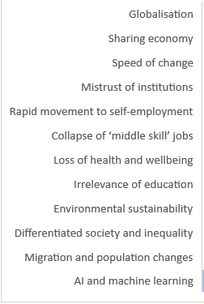
Notes:
Compare the disruptions form the snowball game to the disruptions on this slide.

Slide 6
Notes:
This is an example of one of the disruptions where there is falling demand for middle skilled jobs and increased demand for higher skilled jobs and low skilled jobs.
Some people with middle skills might find themselves in lower skilled jobs.
Fusion Skills are higher skills.
The pattern is very similar across most economically developed and developing economies.

Slide 7
Notes:
Discuss the impact of AI and automation on jobs. What jobs are most likely to be impacted and why?
This report is a useful reference for the discussion:
https://www.brookings.edu/wp-content/uploads/2019/11/2019.11.20_brookingsmetro_what-jobs-are-affected-by-ai_report_muro-whiton-maxim.pdf
Discuss the qualities/skills that are likely to be in demand. The following reports can be a reference:
https://www.forbes.com/sites/bernardmarr/2019/04/29/the-10-vital-skills-you-will-need-for-the-future-of-work/
https://www.mckinsey.com/industries/public-and-social-sector/our-insights/defining-the-skills-citizens-will-need-in-the-future-world-of-work
https://www.topuniversities.com/student-info/careers-advice/future-skills-youll-need-your-career-2030
Are there skills in common on the lists?

Slide 8
Qualities for the future
Curiosity, ability to question and to research
Innovation and creativity
Multi-disciplinarity and ability to connect, develop own networks, to empathise and collaborate
Adaptability, responsiveness, agility
Designing and making, understanding and use of data;
Entrepreneurship/social entrepreneurship, leadership, ability to explore/let others explore new ideas,
Coping with and learning from failure
Autonomy, learning to learn, lifelong learning
Notes:
Pair discussion of situations in everyday life where you have used the skills highlighted in pink and underlined.

Slide 9
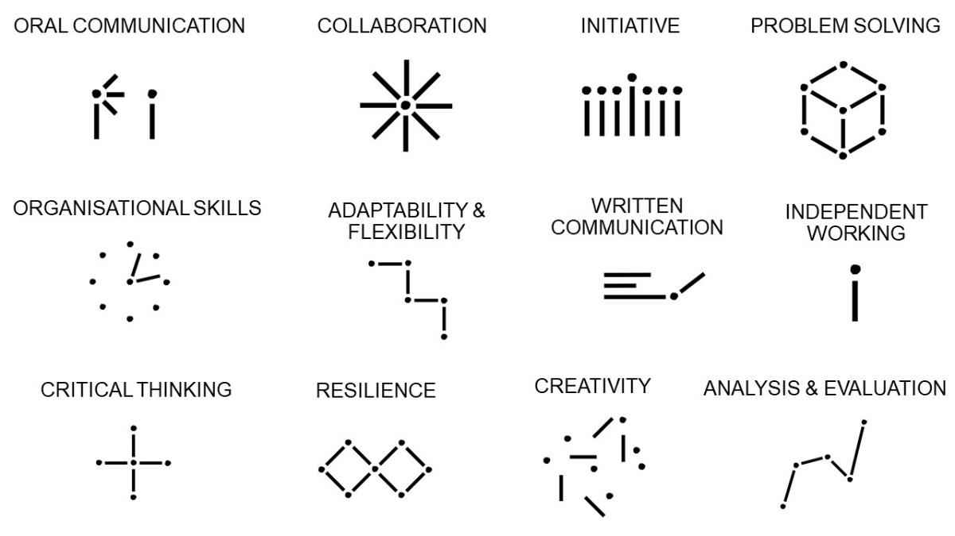
Fusion skills
Notes:
For a Fusion Skills animation and more information on Fusion Skills look at https://findfusion.org.uk/fusion-skills/
Refer to Fusion Skills definitions handout.
Learners in small groups give everyday examples for each of the Fusion Skills.

Slide 10
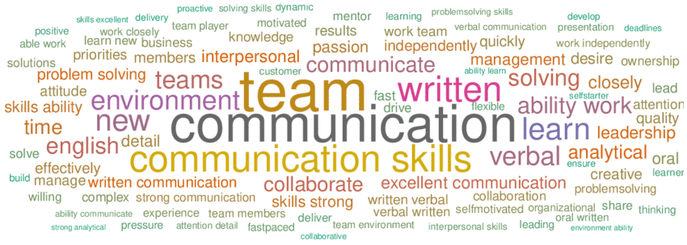
There are many different words used for Fusion Skills and different sets of skills included.
Have a look at this report as to why the 12 Fusion Skills were chosen: https://www.cityoflondon.gov.uk/assets/Services-DCCS/transferable-skills-in-the-workplace.pdf.
Notes:
Develop a group word cloud of words often used for ‘fusion skills’ including transversal skills, future skills, essential skills, interdisciplinary skills, soft skills, transdisciplinary, transferable skills, life skills, etc. Brainstorm as many words as possible to create the word cloud. This software can be used https://www.mentimeter.com/features/word-cloud
Are there some skills you thought would be in the Fusion Skills list of 12 words that are not there? Make a group list of these words.
Many

Slide 11
T-shaped People
FUSION STRENGTHS
SPECIALIST STRENGTHS
Notes:
Provide the T-shaped Handout.
Based on the Fusion skills definition, write your top three Fusion strengths along the top of the T (the horizontal). Share these as a class.
On the vertical, list your three top specialist skills e.g. “I can use excel”

Slide 12
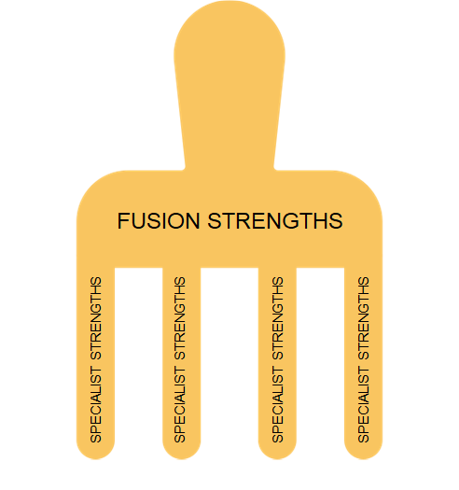
Comb-shaped people
Notes:
People are increasingly having many specialisms.
How many different specialist jobs or tasks have you done, or can you do?

Slide 13
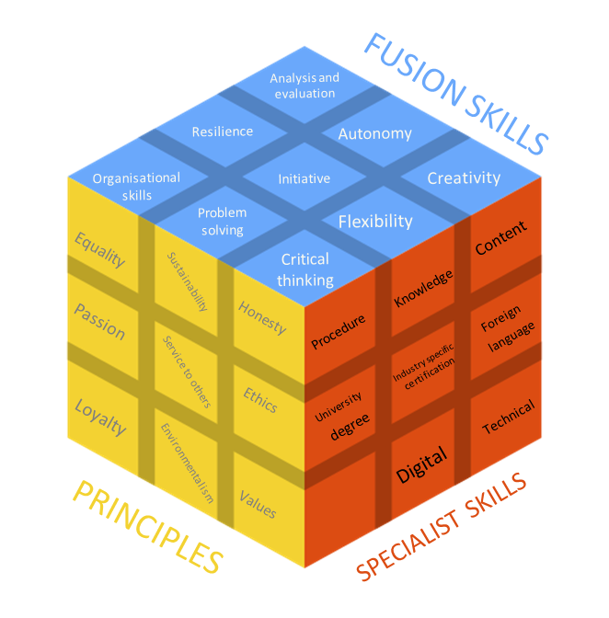
Cubed-shaped people
Notes:
Shoe how the Rubik’s cube is a good way to demonstrate that in everyday learning and work-based tasks combine our Fusion Skills, our specialist skills and increasingly also our values and principles.
- You may want to have some Rubik’s cubes available to assist the discussion.

Slide 14
How are Fusion Skills described in job advertisements?
Look at the following link:
https://www.zippia.com/advice/linkedin-skills/
Identify all the Fusion Skills in the list.
Now go onto your favourite job searching site. Search a job you might be interested in. Look at the top ten advertisements in this area and find how many Fusion skills are included in the wording of the advert. Count every time one of the Fusion Skills is mentioned.
Notes:
Learners can work in groups or individually.
Discuss which Fusion Skills were the most common.
Note that the Fusion Skills definition list is in order of the most popular although all 12 Fusion Skills are highly desirable.

Slide 15
Self-Assessment of Fusion Skills
Notes:
Two platforms are suggested for using for the Fusion Skills self-assessments – the Skillsbuilder Benchmark Tool or the WILD App. If there is time learners could do both and compare the results
https://www.skillsbuilder.org/benchmark
https://wildlearn.co/

Slide 16
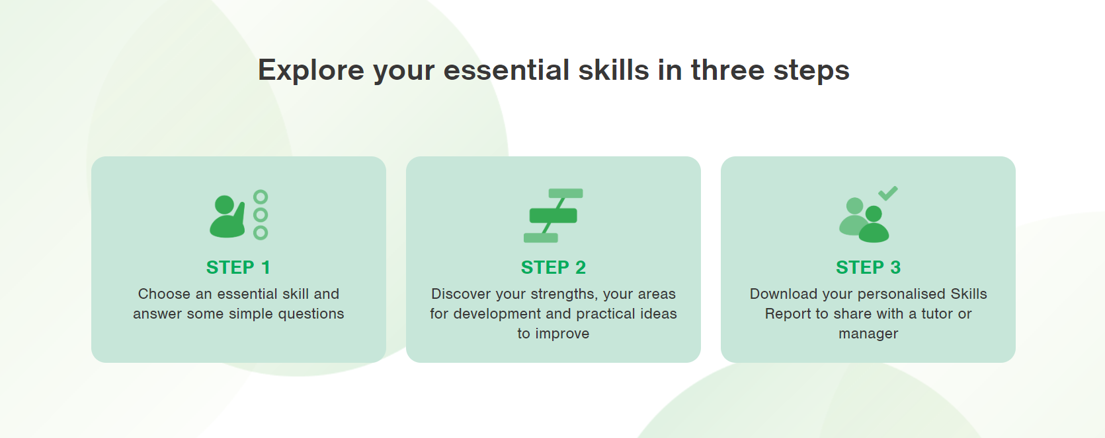
https://www.skillsbuilder.org/benchmark

Slide 17
https://wildlearn.co/
Notes:
Compare the results and discuss the similarities and difference between the two self-assessment tools.
Group discussion. What surprised you? How did the results compare to you original T-shaped assessment?

Slide 18
Break 15 Minutes

Slide 19
Notes:
Discuss the importance of being a lifelong learner.
How can you enhance your capacities for lifelong learning?
Why do you think there is significance of becoming a lifelong learner of Fusion Skills?
What can you do to be a lifelong learner?

Slide 20
Ways to become a lifelong learner
Develop a growth mindset- embrace challenges, change and critique ways to learning
Take responsibility for the future - give yourself the power to make changes
Discover and follow your passions – and cultivate new opportunities by learning additional skills and techniques
Be a lynchpin - hold everything together and keeps things moving in the right direction.
Stretch beyond your own expectations and those set by others – step outside your comfort zone in a positive way
For more on growth mindsets please look at https://www.mindsethealth.com/matter/growth-vs-fixed-mindset

Slide 21
Lifelong learning and managing change
CHANGE STARTS
HERE
Current Conditions
Commitment
Denial
Responsibility
Resistance
Exploration
Altitude Trough
Notes:
- What things have forced you to change over the past two years?
What strategies did you use to cope with the changes?
Talk through the change cycle.
How might Fusion Skills make you better equipped to cope with change?

Slide 22
Planning your personal learning journey
Choose one of the Fusion Skills you feel it is important to develop further.
Using the data base supplied and your own web searches, find three or more training materials or opportunities that could be used to develop the skill you are focusing on.
Use the template provided to develop a short personal learning plan, including the training resources you have found.
Notes:
Based on the self-assessments conducted, choose one Fusion Skill you would like to develop further. It can be because it is one you are weaker in or one you feel is very important to develop.
From the data base provided and/or web searches, find three or more training materials or opportunities that can be used to develop the skill you are focusing on.
Discussion and sharing of findings
Using the template/s provided, develop a short learning journey aimed at developing the fusion skill highlighted. Learners can be grouped particular fusion skills for support.
What are SMART targets in a personal learning plan?
Review learning plans to consider if some SMART targets can be developed.
Create: a visual plan with a slogan to show you learning journey ahead.

Slide 23
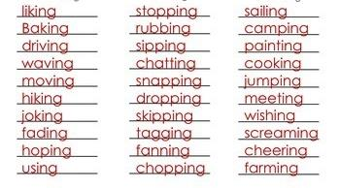
I am committed to…
The importance of verbs… actions.. Words ending in ‘ing’
Notes:
Link the use of verbs to the creation of SMART targets
Use the SMART Verbs Handout.

Slide 24
Next practice… not best practice…
Notes:
Stress the importance of making small and achievable steps
‘Next steps’ are better than ‘best practice’ which might stop a person moving forward.
Learners complete a Fusion Skills Based course evaluation – use the Fusion Skills Evaluation handout.
Learners may wish to share something from their personal learning plans or their slogans and images.
The course finishes.

